Slide 1
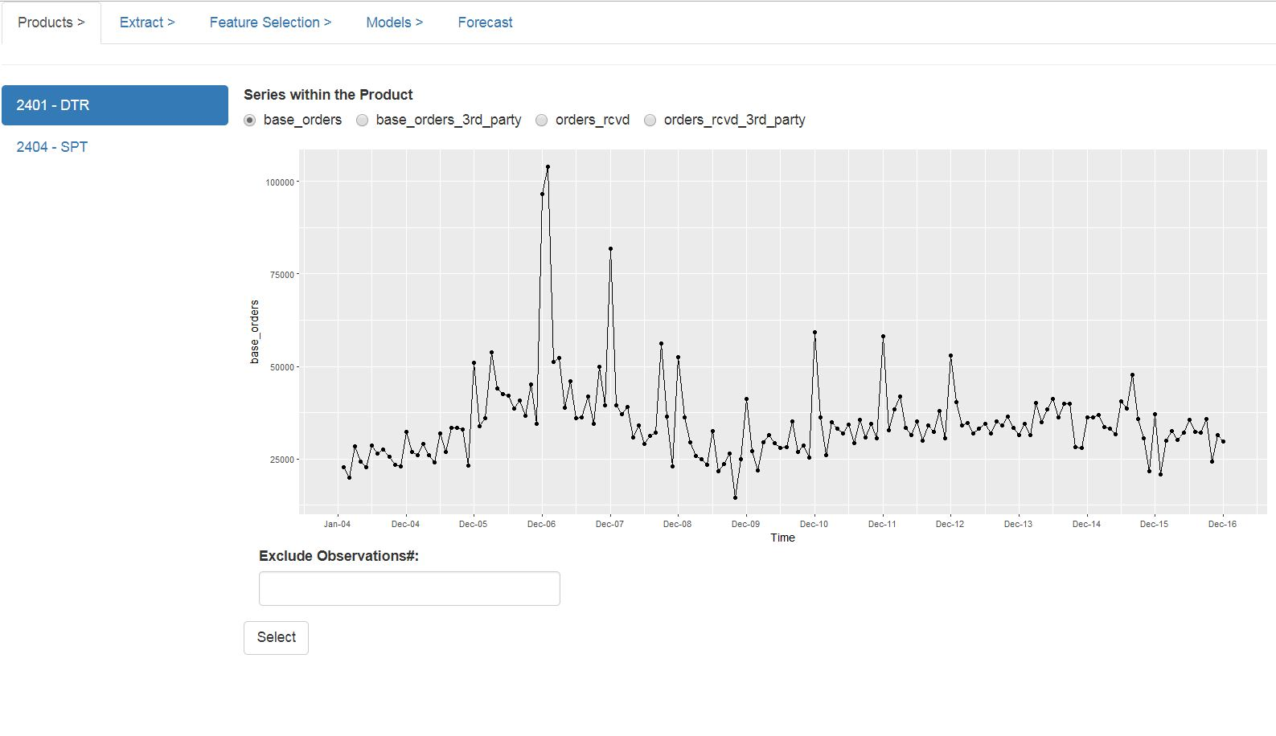
Step 2: Select the revenue type
Step 3 [Optional] : Select observations to be excluded by
clicking on the data points. Such points
would be listed in the “exclude observations#”
box.
Step 1: Select Product
Line
Step 4: Finalize the selection

Slide 2
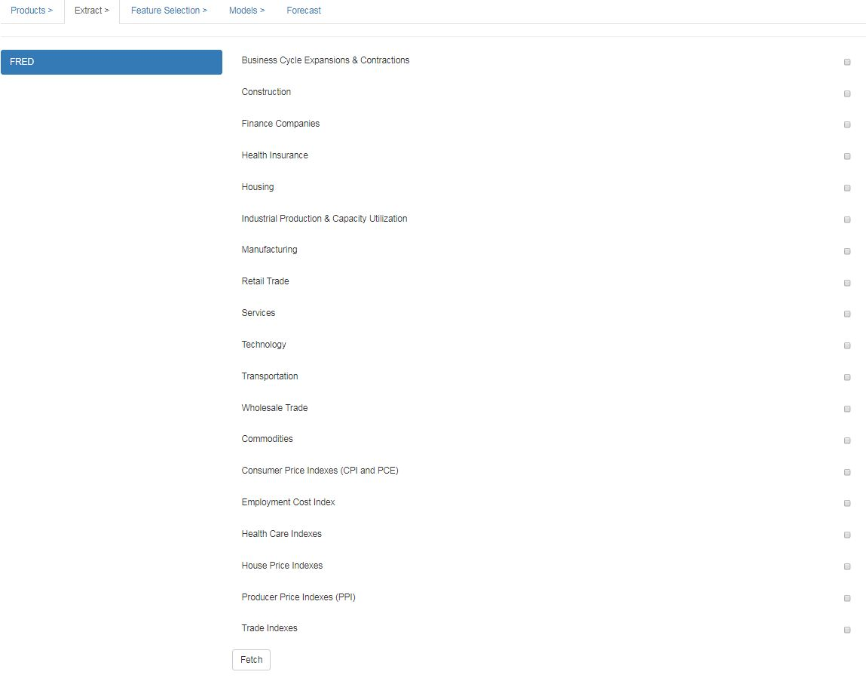
Step 1: Select the
subcategories that
needs to be fetched
NOTE: The steps in this tab can be
skipped if the external data has been
fetched and stored in the local system.
Step 2: Click to Fetch the selected sub-categories. It takes a while to fetch them.

